Slide 1
Project 2 : Employee Attrition Analysis
Bob Wu
George Hu

Slide 2

Background:
Employee attrition results in the reduction of staff by voluntary or involuntary reasons.
A high turnover rate can be costly. When you think about your investment in recruiting and training employees and only having them stay on for a short period of time, you are not getting back a return on your investment.
There are also intangible costs like the decline in productivity due to the change in office dynamics and the loss of institutional knowledge.

Slide 3
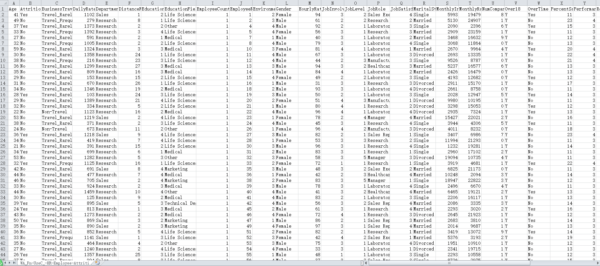
Data Source: IBM HR Analytics Employee Attrition & Performance Link: https://www.kaggle.com/pavansubhasht/ibm-hr-analytics-attrition-dataset
Project target:
Find top factors that influence employee attrition

Slide 4
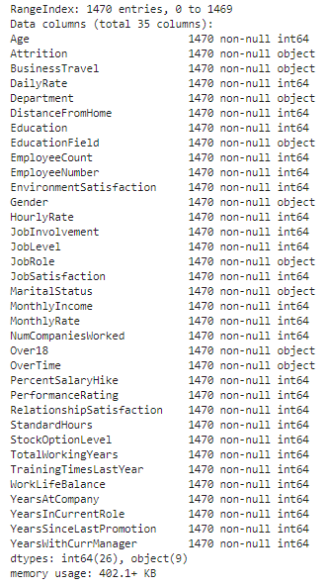
Nature of data:
File:WA_Fn-UseC_-HR-Employee-Attrition.csv
1470 employees
Factors including Attrition, Age, BusinessTravel, DailyRate, Department , DistanceFromHome, Education, EducationField, EmployeeCount…etc (35 in total )
Number of records: 51450

Slide 5
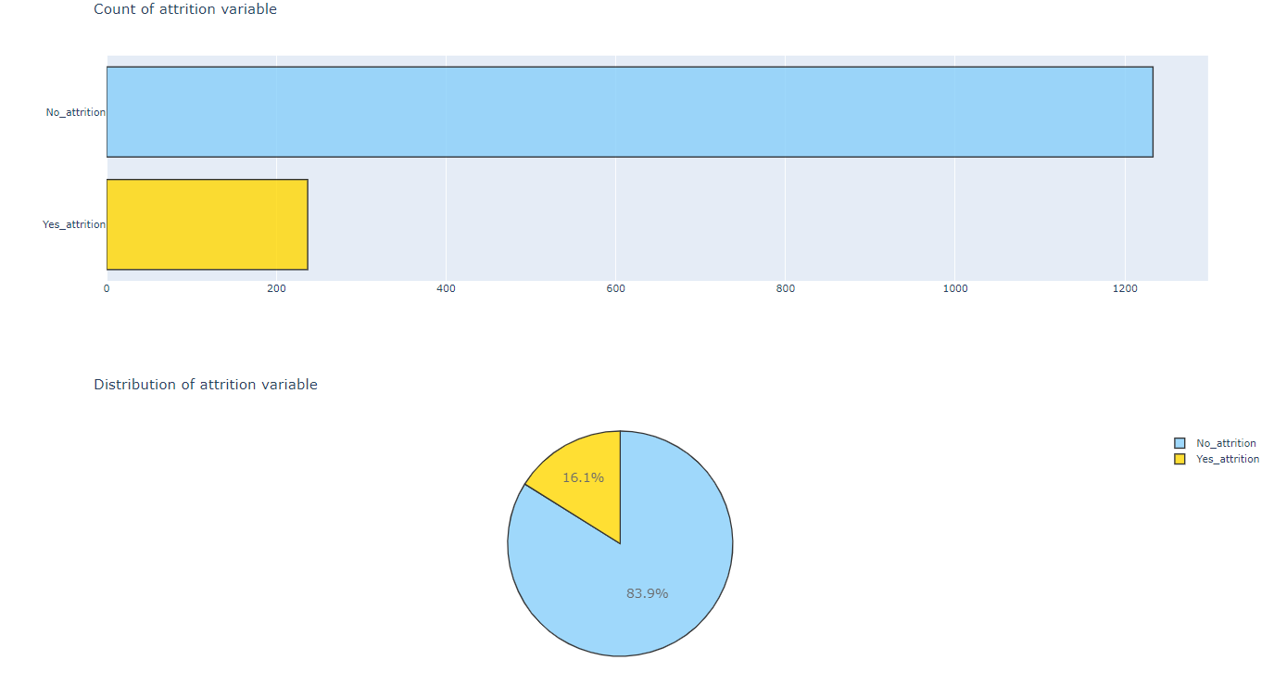
Attrition count and distribution in IBM

Slide 6
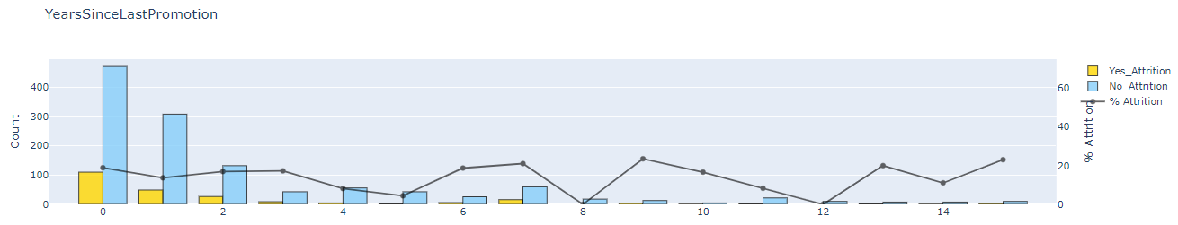
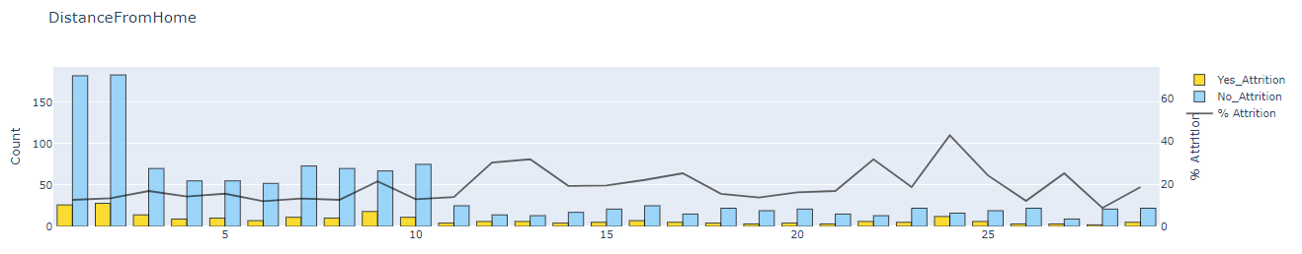
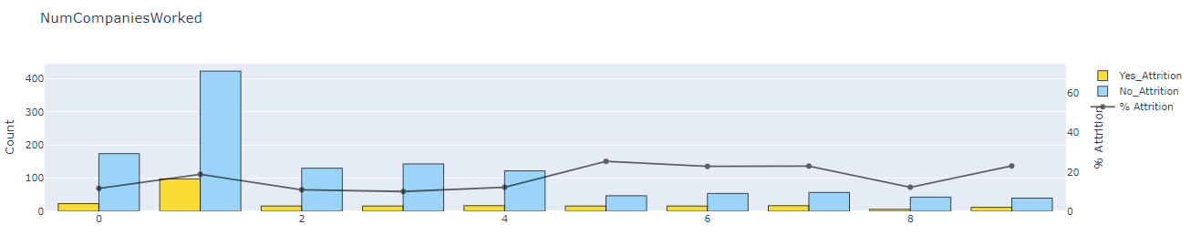
Different Factors distribution (example):

Slide 7
Data processing
Drop unnecessary data: EmployeeCount, EmployeeNumber, Over 18
Mapping target value: from Yes/No to 1/0
Divide features into two categories:
Numerical data such as Age, DistanceFromHome, HourlyRate
Categorical data such as BusinessTravel, Department

Slide 8
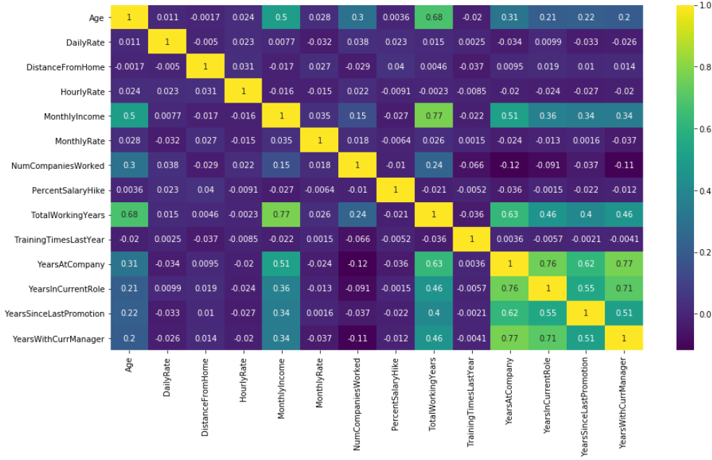
For Numerical data:
Check with heat map
None of the correlations of two different features are over 0.8, which means each two different data are not highly correlated

Slide 9
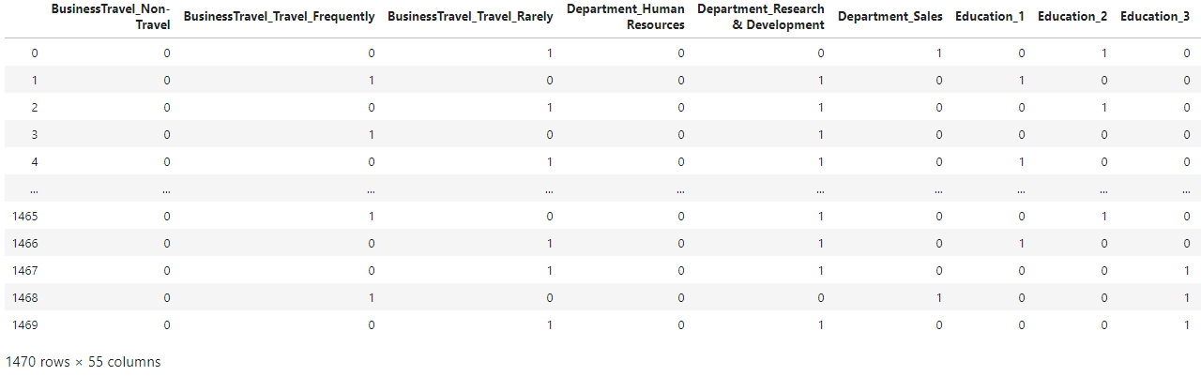
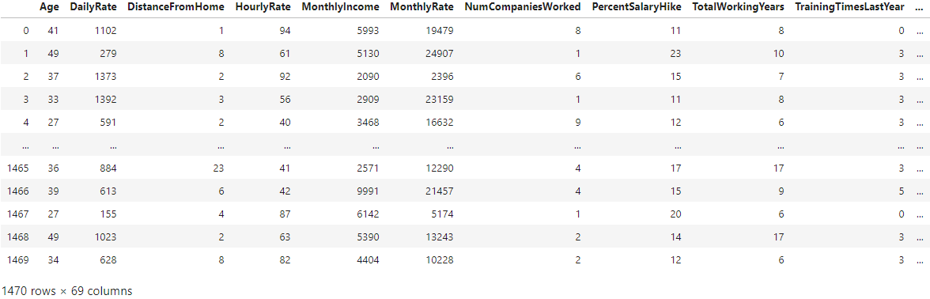
For Categorical data:
Converted into Dummy Variables
than combine with Numerical data

Slide 10
Implementing Machine Learning Models
Splitting Data into Train (80%)and Test (20%)datasets
Training with Machine Learning models
Compare the score of different models:
Decision Tree Classifier: 0.761904
Random Forest Classifier: 0.884353
Logistic Regression: 0.870748
K Neighbors Classifier: 0.846938
SVC: 0.867346

Slide 11
Improving Machine Learning Models
Standardizing the features with MinMaxScaler
Re-training with Machine Learning models
Compare the score of different models:
Decision Tree Classifier: 0.761904
Random Forest Classifier: 0.867346
Logistic Regression: 0.891156
K neighbors Classifier: 0.887755
SVC: 0.867346

Slide 12
Improving Machine Learning Models
Implementing SMOTE to improve imbalanced data
Re-training with Machine Learning models
Compare the score of different models:
Decision Tree Classifier: 0.816326
Random Forest Classifier: 0.860544
Logistic Regression: 0.887755
K Neighbors Classifier: 0.806122
SVC: 0.880952

Slide 13
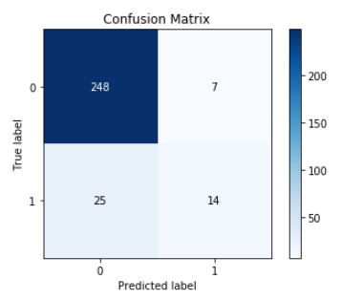
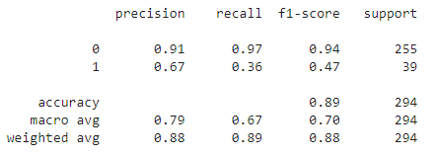
Best model: Logistic Regression with MinMaxScaler standardized features
Classification Report

Slide 14
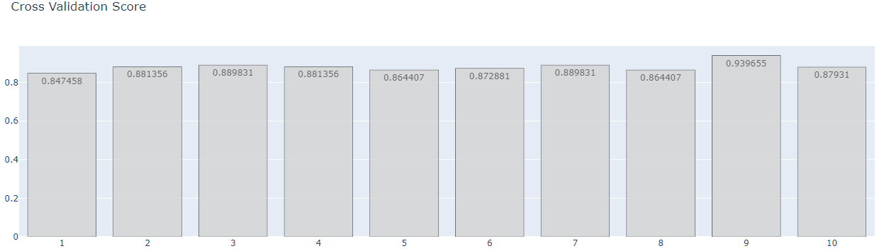
Cross-validation
The result is consistent

Slide 15
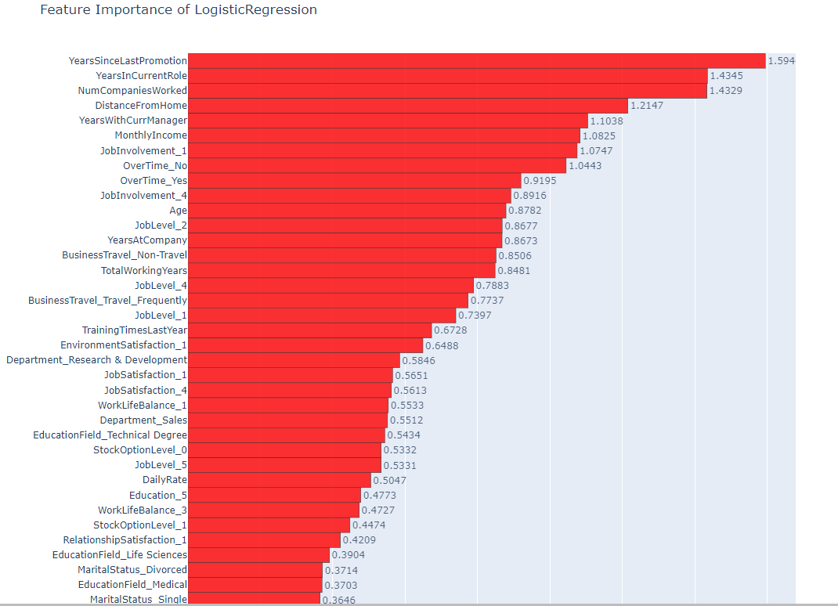
Feature Importance of LogisticRegression

Slide 16
Conclusion:
According to our regression model, the top factors for employee attrition are:
YearsSinceLastPromotion
YearsInCurrentRole
NumCompaniesWorked
DistanceFromHome
YearsWithCurrManager
MonthlyIncome
JobInvolvement
OverTime

Slide 17


